Slide 1
Law Enforcement Partnership Forums
LE Forums have been held in various formats throughout the country for one purpose:
Solicit law enforcement’s concerns, challenges and suggested solutions regarding traffic safety engagement

Slide 2
Primary Obstacles for Traffic Safety Engagement
Three General Categories:
1. Leadership
2. Resources
Personnel
Training
Equipment
3. Operational Deployment
Notes:
Modify heading

Slide 3
Leadership
Support and promote TS champions at the executive and leadership levels
Promote the Return on Investment for traffic enforcement, quality of life, impact on crime reduction
Encourage sharing of resources, people & equipment
Create Regional Impaired Driving / Crash Reduction Task Forces, include regional/countywide sharing of data analysts
Support the development of traffic safety alliances, associations, etc.

Slide 4
Leadership
Address reduced personnel, increased demands, lack of interest
Improve technology, data collection systems, and predictive analytics
Discuss opportunities for sustained enforcement versus national campaigns
Secondary employment details compete against traffic enforcement
Encourage and promote traffic enforcement as an element of daily operations; make traffic safety a core value
If it’s important to you, it’s important to your personnel; we need your help

Slide 5
Navigating Through the Global Drugged Driving Landscape from the Chief’s Seat
By
Chief Robert L. Ticer, DRE Instructor
Loveland Police Department

Slide 6
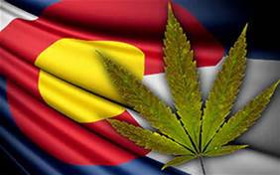
Colorado Today….
Amendment 64-Constitutional Change
2013-Recreational and Medical Marijuana
BE PREPARED!

Slide 7
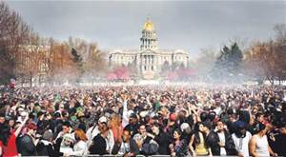
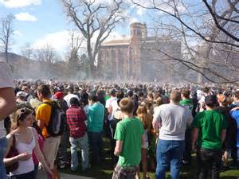
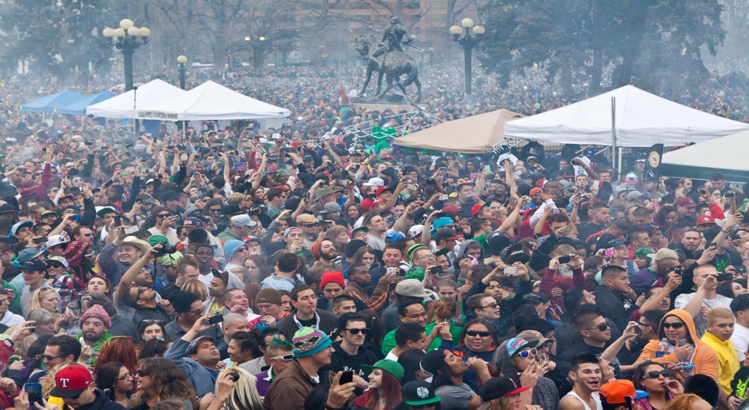
Colorado is the healthiest State in the Union!!!!!!!!!!!
Notes:
Colorado boasts to be one of the healthiest states, yet there are over 130,000 people who need “Medical” marijuana. By the way medical marijuana is marijuana.

Slide 8
Opportunity and Timing is Now
Legalization of Marijuana
Lowering drug crimes to lesser classifications
Crashes up, fatals up, DUID is up…..
Public’s perception of risk (including jury nullification)
Strong Leadership on State DUI Task Forces-Partner with the Marijuana Industry-What????-We must grow as LEADERS!

Slide 9
Involvement now and later
Seat at the table for new legislation and in Task Forces prior to changes of drug laws.
Be prepared-get the subject matter experts to attend. DRE’s, SRO’s, Narcs.
Budget-set this up ahead of time. Budgets for Education and Enforcement.
Tie in funding for Drug Impaired Driving. DRE and ARIDE.
Be careful of permissible inference or per se levels for TCH in the blood.

Slide 10
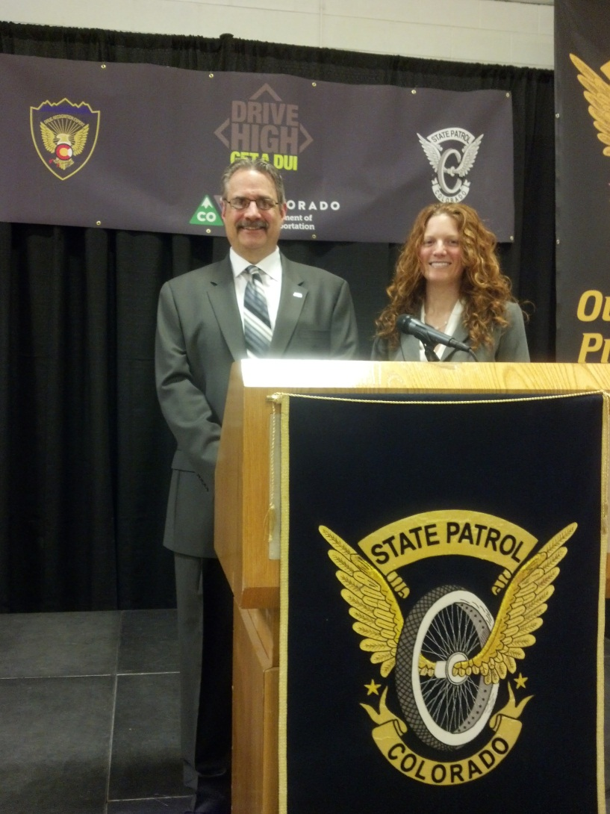
Engage the Community!
Educational Opportunities are endless now.
Perception of Harm Conversations.
DRIVE HIGH GET A DUI…..

Slide 12
Focus on Traffic Safety the same as you focus on Crime Reduction
Funding opportunities for DRE and ARIDE.
Get the right officers for this skilled assignment. Train all in ARIDE-some in DRE.
COPS are crime fighters-This is your buy in!
Consider DDACTS
Reengage for Traffic Safety and DUI (all DUI).
Focus on public health and costs associated with DUI crimes.

Slide 13
Thank You!
Robert L. Ticer
Chief of Police
Loveland Police Department
Bob.ticer@cityofloveland.org
W: 970 962 2222
C: 970 290 9579

Slide 14
JOHN MARSHALL NHTSA’s ACTIONS MOVING FORWARD

Slide 15
Moving Forward
Officer Safety Initiatives
Below 100
Move Over Awareness
Creation of national PSA’s that offers public support of law enforcement. Communicate benefits of traffic enforcement and its relation to the quality of life in communities
Development of NHTSA funded work groups for ongoing related efforts, GHSA, IACP, NSA.
Notes:
Ted

Slide 16
Moving Forward
National LEL Training Conference to be held in November 2017; traffic safety re-engagement is a primary focus of the agenda
Creation of a national traffic leadership training program – command, supervisory, and line officers
Exploring other potential funding sources with our federal partners for traffic enforcement officers

