Slide 1
Association of National Stakeholders in Traffic Safety Education (ANSTSE)
2017
Novice Teen Driver Education and Training Administrative Standards
Notes:
Thank you for the opportunity to be with you today.
This presentation will focus on the very important topic of novice teen driver education and will provide an overview of the Novice Teen Driver Education and Training Administrative Standards (NTDETAS) and how they can assist in reducing teen crashes and fatalities.

Slide 2
Presentation Topics
■ The Stakeholder Association- ANSTSE
■ NHTSA’s Support for Driver Education
■ The Novice Teen Driver Education and
Training Administrative Standards (NTDETAS)
■ Instructor Training Curriculum/System
■ Technical Assistance
■ Taking Action
Notes:
The following topics will be discussed during this presentation.

Slide 3
Association of National Stakeholders in Traffic Safety Education
ANSTSE
Origin
Volunteer organization
Premise and goal
Notes:
ANSTSE was formed in 2010 as a result of the NTDETAS Standards project initiated by NHTSA.
ANSTSE is made up of volunteers representing National Organizations involved in teen traffic safety.
Premise of voluntary consensus-seeking partnerships that identify and advocate areas of common ground for the improvement of traffic safety education in America

Slide 4
ANSTSE Members
AAA Foundation for Traffic Safety
American Association of Motor Vehicle Administrators (AAMVA)
American Driver and Traffic Safety Education Association (ADTSEA)
AAA
Driver Education and Training Administrators (DETA)
Driving School Association of the Americas (DSAA)
Governors Highway Safety Association (GHSA)
Transportation Research Board (TRB)

Slide 5
ANSTSE Mission
Promote adoption of the Standards
Maintain and update the Standards
Support, encourage and strengthen shared-decision making
Identify and make recommendations

Slide 6
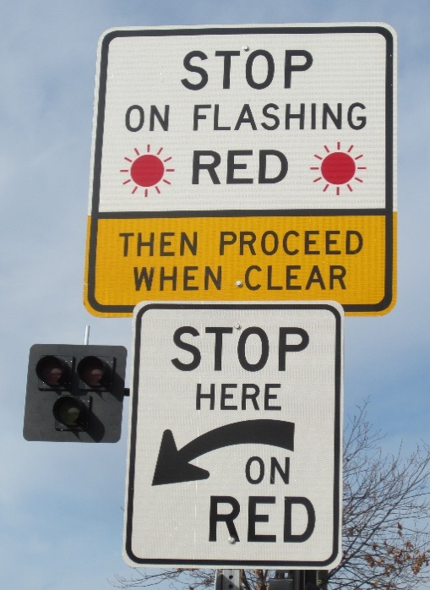
NHTSA’s Support for Driver Education
The NTDETAS
ANSTSE Activities
Strategic Plan
Technical Assistance for states
NHTSA State DE Assessments
Information Sharing System
Visit www.anstse.info and www.nhtsa.gov
Notes:
NHTSA has supported driver education since the development of the NTDETAS and continues to provide support and funding for driver education initiatives.
These links are valuable resources for improving driver education programs.

Slide 7
NHTSA’s Support for Driver Education
NTDETAS Standards & Strategic Plan
Information Sharing System
DRIVER EDUCATION
(ANSTSE)
NHTSA State Assessments
ANSTSE State Technical Assistance
Notes:
In partnership with ANSTSE, NHTSA provides support for a variety of activities designed to enhance driver education programs.

Slide 8
Novice Teen Driver Education and Training Administrative Standards
Revised and published in February 2017
Ultimate Goal: Ensure that driver education and training is:
High quality
Consistent
Administering education standards and policies are a State’s right
To serve as an anchor for State policies on driver education and training
Notes:
States are encouraged to adopt and implement the standards contained in the NTDETAS to assist in their efforts to reduce teen driver crashes and fatalities.
The NTDETAS are recommended and intended to be accepted as the minimum standard for “novice driver education programs” within the United States.
These are all minimum requirements that State’s should strive to achieve.
It is understood that not all States can implement all of the standards at once, but that States should develop a plan to implement these standards incrementally.

Slide 9
Novice Teen Driver Education and Training Administrative Standards
Program Administration
Education and Training (including online delivery)
Instructor Qualifications (program & materials)
Parental Involvement
Coordination with Driver Licensing
Notes:
Program Administration provides standards for the administration, oversight, record keeping, program evaluation, data collection and communication of driver education.
Education and Training provides standards for curricula, instructional time, student evaluation and delivery methods as well as online delivery of driver education.
Instructor Qualifications provides standards for instructor training and qualifications for the training of novice drivers, including prerequisites, course content from State approved driver education curricula, the teaching task, a student teaching practicum, exit assessments and ongoing training and recertification. Two attachments are included for the stages of a driver education instructor preparation program and model training materials for teaching driver education instructors.
Parental Involvement provides standards for supervised driving practice, a parent seminar, parent progress reports and parent resources.
Coordination with Driver Licensing provides standards for communication between the state driver education agency and the driver license authority; the GDL system; coordination and education with courts and law enforcement; requirements for the knowledge and skills tests.

Slide 10
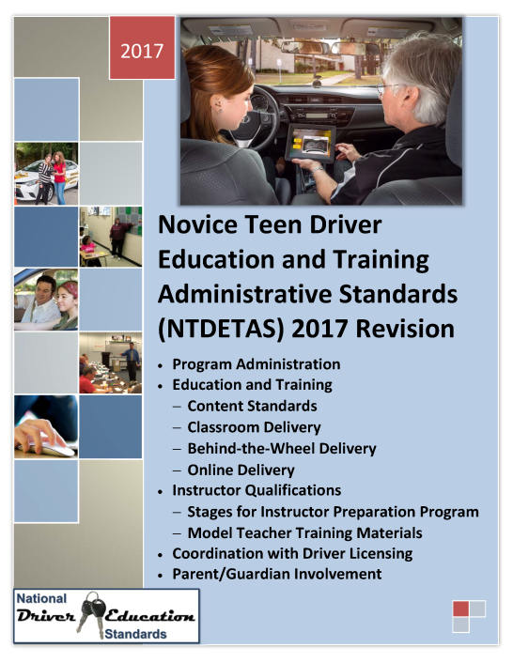
Novice Teen Driver Education and Training Administrative Standards
A few highlights of the revisions include:
Content Standards (ADTSEA & DSAA)
Delivery Standards
Online Delivery Standards
Instructor Training Standards
Notes:
The NTDETAS, revised in 2017 by ANSTSE, are a key highway safety countermeasure for states to use in improving teen driver safety. A few highlights of the revisions include:
Content Standards (ADTSEA & DSAA)
Delivery Standards
Online Delivery Standards
Instructor Training Standards

Slide 11
Novice Teen Driver Education and Training Administrative Standards
Notes:
Example of “shall” and “should” from the standards.

Slide 12
A. Content Standards
Two documents:
ADTSEA Curriculum Standards
DSAA Content Standards
Model standards for:
Curricula, and
Other teaching materials.
Notes:
Content standards are incorporated in the NTDETAS by reference. They are comprised of two documents:
the ADTSEA Curriculum Standards, and
the DSAA Content Standards.
The purpose of these documents is to serve as model standards to aid in the development and evaluation of driver education curricula and other teaching materials.
These can be found in Attachments A and B.

Slide 13
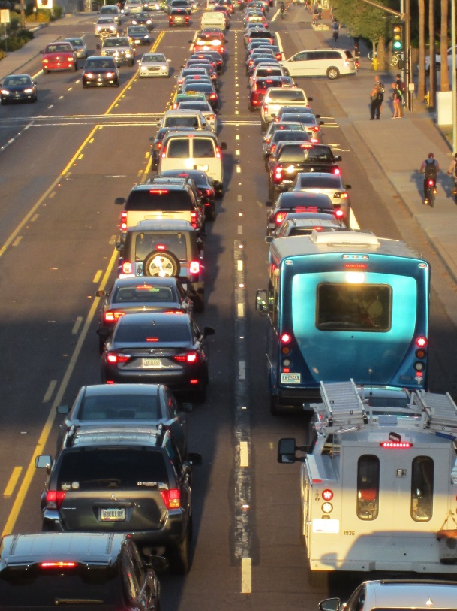
B. Delivery Standards
Minimum guidelines on topics including:
Concurrent and integrated instruction
Classroom & BTW time periods
Student-instructor ratio
Requirements: Classrooms & training vehicles
Use of simulation, driving range, and computer-based learning
Notes:
Delivery standards provide minimum guidelines for delivering driver education on a number of important topics, including:
Concurrent and integrated time
Classroom and BTW time period
Student to instructor ratio
Classroom requirements
Training vehicle requirements
The use of simulation, driving range and computer-based learning substitution hours for BTW
Delivery standards focus exclusively on the “How” to deliver driver education instruction.
They establish the process for “How” driver education is delivered in an effort to improve the overall quality of instructional delivery methods which benefit the novice learning driver.
The delivery standards are contained within Section 2 of the NTDETAS.

Slide 14
C. Online Delivery Standards
To improve the quality of online driver education programs nationwide
Notes:
Online delivery standards for driver education will improve the quality of online driver education programs nationwide.
Provides consistency in “how” online driver education programs are delivered.
The online delivery standards are contained within Section 2 of the NTDETAS.
Reached out to the major online providers to partner and seek their input.

Slide 15
C. Online Delivery Standards
Includes guidelines on:
Instructional design
Structural design
Notes:
The online delivery standards provide minimum guidelines for delivering online driver education on a number of important topics, including:
Instructional design – how to organize, standardize, communicate and examine the instructional content of the online course.
Structural design – describes how the course will be implemented in order to meet the learning and course requirements.

Slide 16
C. Online Delivery Standards, cont.
Evaluation/testing/ assessment
Technological design and capabilities
Legal requirements
Notes:
The online delivery standards also address:
Evaluation/testing/assessment– how and what type of evaluation will be carried out for learners, the course and online instructors.
Technological design and capabilities – minimum technological tools and/or capabilities.
Legal requirements – how to protect learner privacy, verify learner participation and test taking and comply with state/federal requirements for driver education and certification.

Slide 17
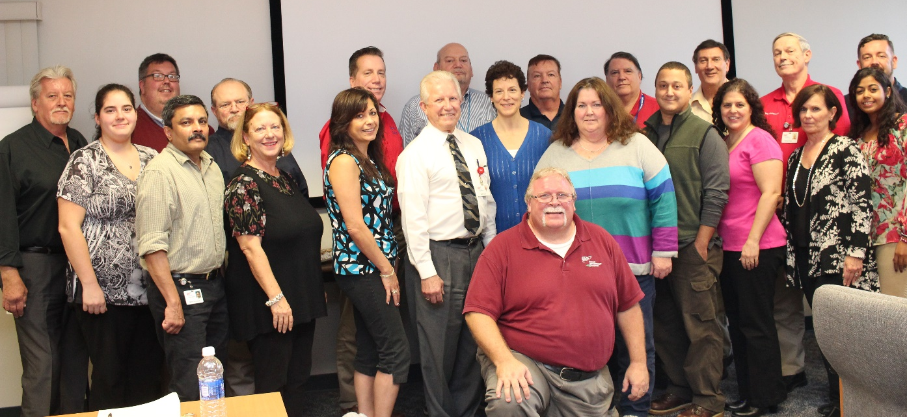
D. Instructor Qualification Standards
Proper instructor training is paramount
Teaching theory and practice- the focal point
Ample time for training
Notes:
Proper training of driver education instructors is paramount to the success of every State’s driver education program.
Content relating to teaching theory and how to teach driver education must be the focal point of the driver education instructor preparation program.
Ample time must be devoted and required for successful completion.

Slide 18
D. Instructor Qualification Standards
Prerequisites and entry-level assessments
Training of instructors:
course detailing information from State approved driver education curricula
course in teaching and learning theories
deliver practice teaching assignments
Notes:
The instructor qualification standards provide minimum standards for instructor training, including:
Prerequisites and entry-level assessments for instructor candidates.
Training of instructors – a course detailing information from State approved driver education curricula, course in teaching and learning theories and deliver practice teaching assignments.

Slide 19
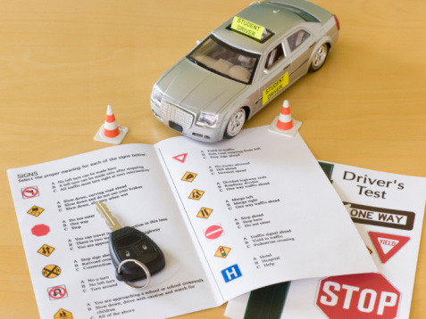
D. Instructor Qualification Standards
Having candidates teach with an experienced mentor or complete a student teaching practicum
Pass exit assessments
Require ongoing training and recertification
Notes:
The instructor qualification standards also include:
Recommendations for candidates teach with an experienced mentor or complete a student teaching practicum.
Passing exit assessments.
Requiring ongoing training and recertification.

Slide 20
Stage 3: The Teaching Task
Model curriculum consists of:
Part I: Fundamental Concepts of Teaching and Learning
Part II: Classroom Teaching and Learning Theories
Part III: BTW Teaching and Learning Theories
Notes:
A Model Curriculum was developed for the teaching task.
The teaching task consists of:
Part I Fundamental Concepts of Teaching and Learning
Part II Classroom Teaching and Learning Theories
Part III BTW Teaching and Learning Theories
It is recommended that instructor candidates complete all 3 parts, however, instructors can be trained to conduct classroom (Parts I&II only) or BTW (Parts I&III only).

Slide 21
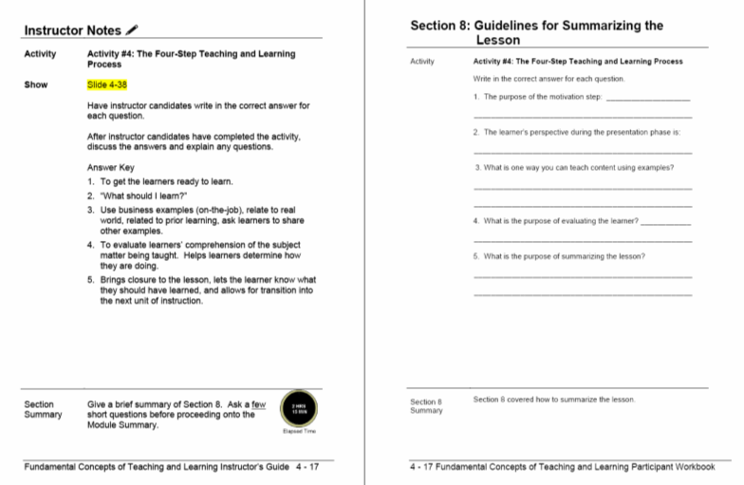
Stage 3: The Teaching Task
Includes Instructor’s Guide and Participant Workbook:
Lesson Plans with classroom and BTW activities
Slides
Videos for BTW part
Quizzes/Answer Sheets
Knowledge Tests/Answer Sheets
Notes:
The model curriculum materials includes:
An Instructor’s Guide and a Participant Workbook which consists of:
Lesson Plans with classroom and BTW activities
Slides
Videos for BTW Part III
Quizzes/Answer Sheets
Knowledge Tests/Answer Sheets

Slide 22
Stage 3: The Teaching Task
Notes:
Here is a close-up of the lesson plan with the instructor notes on the left side and the participant workbook on the right side.

Slide 23
Stages for Instructor Preparation Program
Pre-Screening/
Assessments
Foundations: The Driving Task
The Teaching Task
Student Teaching Practicum
Exit Assessments

Slide 24
Stages for Instructor Preparation Program
Each Stage is a critical component within the “System.”
Altering or omitting a Stage within the “System” will drastically affect the quality of driver education instructors trained.
Many of the Stages require course development by the State or program.
ANSTSE has developed training resources to assist in conducting Stage III: The Teaching Task.
Notes:
Details on the training system can be found in the revised 2017 Novice Teen Driver Education and Training Administrative Standards (NTDETAS) Attachment C – Stages for Driver Education Instructor Preparation Program.

Slide 25
Benefits of the Model Training Curriculum
Will assist all state programs to offer quality driver education instructor training.
Providing commercial, public and private schools with a powerful new resource for training driver education instructors.
Notes:
The instructor training program creates an alternative to university-based driver education instructor training.

Slide 26
The Importance of Driver Education in Vehicle Technology
Driver knowledge and awareness low
Driver education essential
Continuing education to keep pace with new technologies
Drivers need to remain engaged in the driving task
Experienced drivers will also need to be trained
Notes:
While these new technologies have the potential to substantially reduce collisions and fatalities, research shows that driver knowledge and awareness about their proper use is quite low.
Driver education remains essential to ensure that new drivers, as well as more experienced drivers, do not mistakenly under-estimate their role in the safety equation and that they are able to reap the safety benefits offered by these new technologies.
Continuing education for all drivers will be paramount to help them keep pace with new technologies and maximize their effectiveness by reinforcing safe driving practices.
Despite rapid advances in vehicle technologies, it is essential that drivers remain engaged in the driving task and are able to take control of the vehicle with little notice, particularly in high-risk conditions such as inclement weather or heavy traffic.
Vehicle technologies will present new challenges that driver educators must be prepared to address, and continuous driver education may become essential for all drivers, as opposed to just new drivers.

Slide 27
Future Projects Related to Autonomous Vehicles
Educate existing driving instructors on Autonomous Vehicles (AVs) and Advanced Driver Assisted Systems (ADAS).
Bring manufacturers together to discuss how AV and ADAS technologies will affect driver education and training.
Identify and provide resources for instructors and providers to conduct training on the use of vehicle technologies.
Notes:
Objectives are to:
Raise the level of awareness and understanding of driver education instructors on vehicle technology systems.
Provide continuing education opportunities for instructors to become and stay current with vehicle technology systems.
Prepare existing instructors to teach new drivers about current and near-future vehicle technologies.

Slide 28
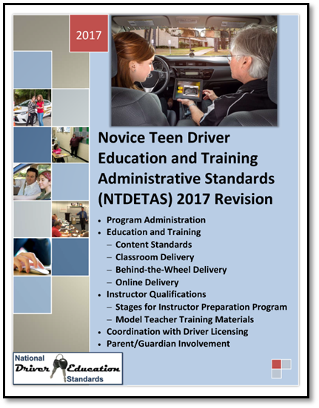
ANSTSE Website
www.anstse.info
Revised NTDETAS.
Model teaching task instructor curriculum.
ANSTSE Strategic Plan.
NHTSA State assessment / ANSTSE technical assistance reports.
Driver education reports and research.
Notes:
www.anstse.info
You can find the following resources on the ANSTSE website:
The revised NTDETAS.
Model teaching task instructor curriculum.
ANSTSE Strategic Plan.
NHTSA State assessment / ANSTSE technical assistance reports.
Driver education reports and research.

Slide 29
ANSTSE Website
Notes:
Here is a snapshot of the ANSTSE website. You can find a quick link to the standards on the left side and on the right side a quick link to the instructor training materials.
Point out other areas for the ANSTSE website including:
About Us
Standards
Technical Assistance
News
Resources
Projects
Links
Contact Us
Information Sharing System

Slide 30
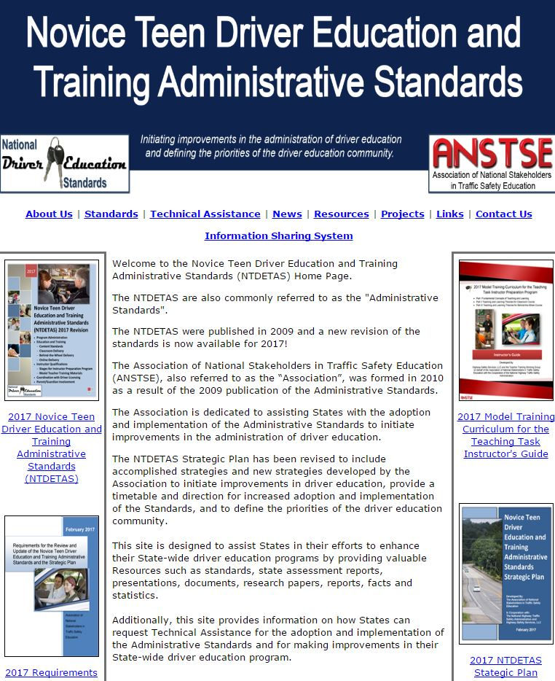
ANSTSE/NTDETAS Technical Assistance
Goal: Assist with adopting and implementing the standards and to make improvements in driver education
State driver education programs can request technical assistance from ANSTSE
No cost to the state
For more information visit www.anstse.info.
Notes:
The goal of ANSTSE/NTDETAS technical assistance is to assist states with adopting and implementing the standards and to make improvements in driver education.
State driver education programs can request technical assistance from ANSTSE, at no cost to the state.
The technical assistance can be on-site at your location or off-site through conference calls and emails.
On-site technical assistance consists of 2 ANSTSE members or driver education experts to meet with state administrators and other entities in regards to driver education.
The team members provide recommendations to the state on portions of the driver education program that are the most critical, for instance program administration and instructor qualifications.
A report is written and provided to the state detailing the recommendations.
To date 9 states have completed technical assistance.
For more information visit www.anstse.info.

Slide 31
The Importance of Standards
Can improve your driver education program.
All programs should utilize the standards even for if the State doesn’t implement or require them.
Can help reduce the number of motor vehicle crashes and fatalities.
Notes:
Emphasize the importance of the standards in raising the bar for driver education programs, both at the state level and locally.

Slide 32
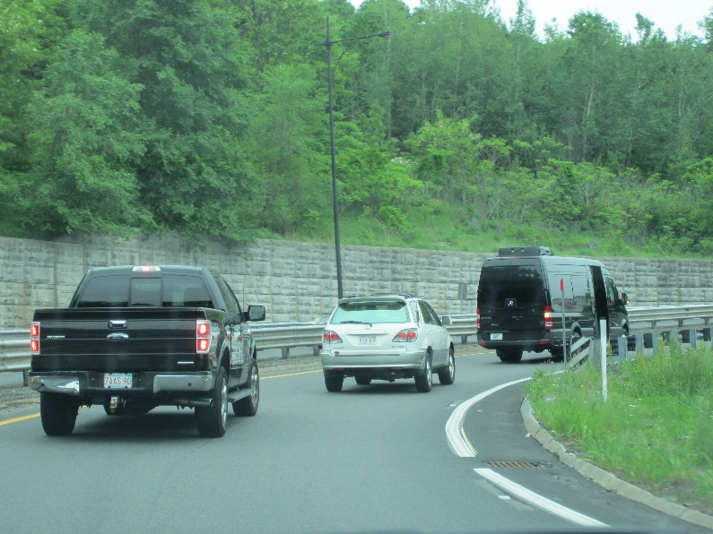
How to Take Action
Monitor progress in Driver Education
Encourage the adoption and implementation of the revised standards, including standards for:
Administration
Program delivery
Instructor training
Notes:
Follow the progress of Driver Education issues for the coming years (major strides have been taken and are being taken to improve Driver Education).
Support and encourage the adoption and implementation of the revised NTDETAS, including administrative, delivery and instructor training standards.

Slide 33
How to Take Action, cont.
Encourage your state to:
Schedule a NHTSA State Driver Education Assessment
Request Technical Assistance.
Work cooperatively within your driver education community.
Follow the efforts of the ANSTSE. www.anstse.info
Notes:
Encourage your state to schedule a NHTSA State Driver Education Assessment or request Technical Assistance.
Work cooperatively within your driver education community.
Get involved in the effort to enhance driver education.
Follow the efforts of the ANSTSE.
www.anstse.info

Slide 34
Thanks to NHTSA!!!
Notes:
ANSTSE extends its’ gratitude to NHTSA for their support in Driver Education and Training!
With there support we will make enhancement to driver education and training programs.

Slide 35
ANSTSE Contact
Brett Robinson
ANSTSE Secretariat
American Driver and Traffic Safety Education Association (ADTSEA)
(724) 801-8246
brett@adtsea.org

Slide 36
NHTSA State Assessment Contact
Michelle Atwell
Highway Safety Specialist, Enforcement & Justice Services
National Highway Traffic Safety Administration
(202) 366-2084
Michelle.Atwell@dot.gov

Slide 37
Questions
Thank you for your support and interest in Driver Education and Training!
?

